Slide 1

The Unified Process
Elaboration
Notes:
‹#›

Slide 2
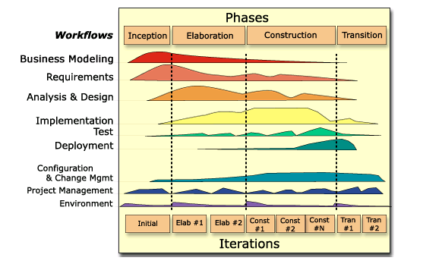
(Rational) Unified Process (R)UP

Slide 3
Iterative Development and RUP
Inception
Elaboration
Construction
Transition
Preliminary
Iteration
Architect
Iteration
Architect
Iteration
Developer
Iteration
Developer
Iteration
Developer
Iteration
Transition
Iteration
Transition
Iteration
Inception: Understand what to build
Vision, high-level requirements, business case
Not detailed requirements
Elaboration: Understand how to build it
Baseline architecture, most requirements detailed
Not detailed design
Construction: Build the product
Working product, system test complete
Transition: Validate solution
Stakeholder acceptance
An iteration is a distinct sequence of activities with an established plan and evaluation criteria, resulting in an executable release.

Slide 4
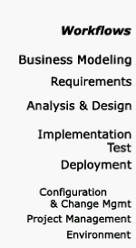

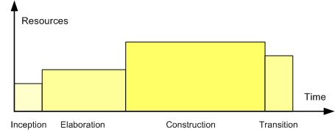
Inception: Know What to Build (review)
Step 1: Prepare vision document and initial business case
Include risk assessment and resource estimate
Step 2: Develop “high-level” project requirements
Initial scenarios and domain models (10-20% complete)
Step 3: Manage project scope
Reduce risk by identifying all key requirements
Acknowledge that requirements will change
Manage change, use iterative process
Inception
Elaboration
Construction
Transition

Slide 5
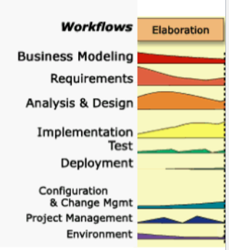
Elaboration: Know How to Build
Detail requirements as needed (~80%)
Less essential requirements may not be fully fleshed out
Produce an executable and stable architecture
Define, code, and test major components and interfaces
Identify dependencies on external components
Key components will be partially implemented
Roughly 10-20% of code is implemented
Drive architecture with your key use cases
20% of use cases drive 80% of the architecture
Design, code, and test key scenarios for use cases
Verify architectural qualities
Reliability (stress), scalability, and Load testing
Continuously assess business case, the risk profile, and the development plan

Slide 6
Specific Objectives with Elaboration
1. Get a more detailed understanding of requirements
Move from 20% to 80% of requirements captured
Deliverable: More complete use case catalog (or other requirements catalog)
2. Design, implement, validate, and baseline the architecture
Make critical design decisions - buy vs build, architectural styles…
Baseline a skeleton structure of your system - build out the interfaces
Deliverable: A buildable “correct”, but minimal, system
3. Mitigate risks, produce more accurate schedule and cost estimates
You know what to build, and having less risk -> accurate schedule
Deliverable: Refine the initial costs, schedules, and risks
4. Deployment and Development environments
Harvest experiences from Inception
Rollout development environment
Work on the production environment plan - acquisition, staging, production design, etc.
Understanding deployment is an issue that is often overlooked!

Slide 7
Objective 1: Get a Detailed Understanding of the Requirements
By the end of Elaboration:
Detail ~80% of use cases
Produce storyboards or prototypes of visually oriented use cases (at least make a mock up)
Walk through the use cases with the stakeholders
For use cases with partial implementations, do a demo
Detail non-functional requirements (all of the ones that have an impact on the architecture! This is the hardest part to analyze so tackle it soonest!)
Time box! You will never be done, fix issues in later iterations
What is not done in Elaboration:
Use cases with no or very limited associated risk (if you have one use case for logging in, do you need more?)
Use cases that are expected to be volatile, and have little impact on the end solution or stakeholder satisfaction

Slide 8
Objective 3: Mitigate Essential Risks and Produce more Accurate Estimates for the Cost and Schedule
Most key risks addressed
Technical risks by implementing and testing the architecture
Business risks by implementing and testing key functionality
Team and tool oriented risks by having the team going through the full software lifecycle by implementing real code using the tools at hand
Schedule and cost estimates can be radically improved as we:
Have mitigated key risks
Understand the vast majority of the requirements
Understand which building blocks need to be implemented and tested
Understand which building blocks can be acquired, and at what cost
Understand how effective our team is

Slide 9
Elaboration Summary
Elaboration - so called as the team should have elaborated the requirements and architecture of the system
At the conclusion of the Elaboration phase the team should have:
Detail and clarity on 80% of the highest priority requirements
An initial architecture implementation that is stable
“Tooled up” environments for development and pre-production
Next in the unified process is Construction, which is implementation
Elaboration is in many ways the most complex phase of UP, because it engages a cross-section of significant activity in every workflow

